Slide 1
French
Business Culture
French Business Culture
AGERCEL

Slide 2
MENU
Section 1
Making appointments
Section 2
Telephoning
Section 3
Receiving clients
Section 4
Business dress code
Section 5
Addressing others
Section 6
Negotiating
Section 7
Entertaining
Section 8
Public behaviour
Section 9
Regional differences
Section 10
How to start a business in France
Final Test
French Business Culture
AGERCEL

Slide 3
Section 1:
Making appointments
French Business Culture
AGERCEL

Slide 4



Punctuality
Section 1: Making appointments
Punctuality is generally considered important, but if you are 5 or 10 minutes late and have a good excuse, it won’t be a disaster.
If you get stuck in a traffic jam and you are likely to be more than 10 minutes late, use your mobile phone to inform the person you are to meet, or their assistant if appropriate.
In the south of France, people are reputed to be a bit more tolerant of lateness, but don’t take too much advantage of this!
Don’t be too early either! The person you’re meeting may feel obliged to see you straight away so as not to keep you waiting. If you arrive 10 to 15 minutes before the appointment, that’s perfect!
French Business Culture
AGERCEL

Slide 5
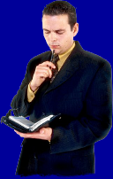

Choosing the right time...
Section 1: Making appointments
When making an appointment, you’ll need to consider the date and the time of course. But in France, you may also need to take account of the day of the week and the time of year.
Click on this button to find out more about French public holidays…

Slide 6
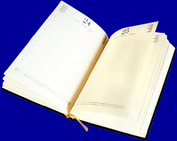
RTT (Réduction du Temps de Travail)
Section 1: Making appointments
Watch out for what the French call « RTT ». This relatively recent phenomenon is another consequence of 35-hour working week.
In many companies and official organisations, agreements have been reached wherby the staff can take days off to make up for extra hours worked. If a person has worked more than the agreed 35 hours, they can take time off, or « RTT » days instead.
Fridays, being close to the weekend, are a popular choice for RTT days
At certain times of year, RTT days and public holidays are combined, which can make it difficult to fit in a meeting or an appointment. This happens in May in particular, but also at other times of the year such as the school holidays at Easter or Christmas.
French Business Culture
AGERCEL

Slide 7
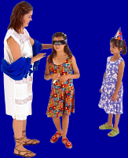
Which day of the week?...?
Section 1: Making appointments
Certain days of the week can also pose a problem. Many women do not work on Wednesdays because children are often not at school on that day. It is quite common for women to work part-time for this reason.
Mondays can also be problematic, as it’s traditional in many comanies to hold weekly meetings on that day.
French Business Culture
AGERCEL

Slide 8


At what time...?
Section 1: Making appointments
For many employees and managers in France, the day’s work starts quite early.
It is not uncommon to start at 8h00, but most people arrive around 8.30 or 9.00 at the latest. You can therefore start suggesting appointments from 9.00 onwards.
If possible, avoid suggesting appointments in the middle of the morning or the middle of the afternoon so that you don’t take up half of the person’s day.
Suggest « early morning » or « late afternoon » …
French Business Culture
AGERCEL

Slide 9
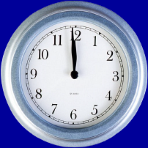
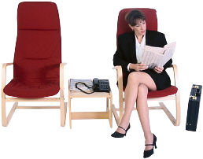
Lunchtime
Section 1: Making appointments
Lunch is still an important part of the day for French people, especially in the provinces. Avoid suggesting appointments at 12.00, unless you intend to invite your contact for lunch at the same time!
The famous « two-hour lunch-break is gradually disappearing, mainly in the larger towns and cities, but it is still wise to suggest appointments after 2.30 pm, just to be on the safe side.
French Business Culture
AGERCEL

Slide 10
Section 2:
Telephoning
French Business Culture
AGERCEL

Slide 11
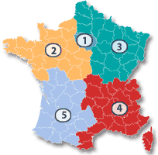
Telephone Numbers
Section 2: Telephoning
Since 1996, all French telephone numbers have 10 figures.
They are usually pronounced in pairs.
Example: 01 23 45 67 89
(fixed line)
..is pronounced: zéro un, vingt-trois, quarante-cinq, soixante-sept, quatre-vingt-neuf.
The first two figures indicate the zone :
01 = Paris and surrounding area
02 = the North-West
03 = the North-East
04 = the South-East and Corsica
05 = the South-West
A number beginning with 06 is a mobile phone number.
Source (à supprimer par Pixel):
http://www.pagesjaunes.fr/
French Business Culture
AGERCEL

Slide 12

Le “barrage secrétaire”
Section 2: Telephoning
In many companies, you will encounter what the French call « the secretarial barrage ». Often, secretaries and assistants are instructed to filter incoming calls. They will not put you through until they have checked who you are, and the reason for your call.
Expressions you are likely
to hear :
C'est de la part...?
(Who’s calling, please?)
Qui dois-je annoncer...?
(Who’s calling, please?)
C'est à quel sujet?
(May I ask the reason for your call?)
French Business Culture
AGERCEL

Slide 13
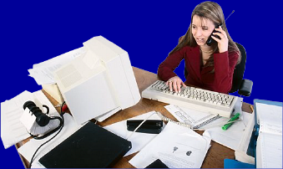
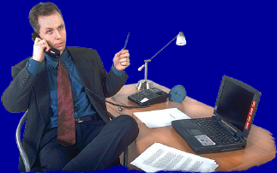
Section 2: Telephoning
Bonjour!
Société Dupont, Bonjour!
If you call the switchboard, the operator will often begin by giving the name of the company
Pierre Dupont !
If you call your contact directly, he may give his name, or simply « Allô? »
French Business Culture
AGERCEL

Slide 14
Section 3:
Receiving clients
French Business Culture
AGERCEL

Slide 15
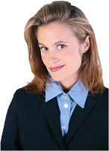

Section 3: Receiving clients
At reception
Veuillez patienter s’il vous plaît . Je la préviens de votre arrivée.
On arriving in a company, your first contact will probably be at the reception desk.
Introduce yourself, giving your name, the name of your firm, and give the name of the person with whom you have an appointment.
As a rule, you would not be expected to shake the hand of the receptionist.
The receptionist will inform your contact that you have arrived, and will ask you to wait. If the wait is expected to be long, she may offer you a coffee. Usually, the person with whom you have an appointment will come to reception to take you to the room where the meeting is to take place.
Bonjour, Je suis M. Lenglet de la société « Duval ». J'ai rendez-vous avec Mme Dupont du service formation.
French Business Culture
AGERCEL

Slide 16
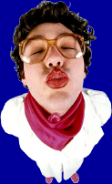
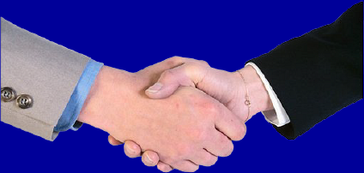
Section 3: Receiving clients
Handshaking
In France, people always shake hands when they meet for the first time (always the right hand).
Colleagues also shake other’s hands when they see each other for the first time that day. However, they don’t usually shake hands when leaving work in the evening.
Nevertheless, if you have spent a day working with your business contact, you can shake their hand again at the end of the day when you leave.
The handshake should be firm and fairly quick (one or two seconds). You should not shake the persons hand up and down several times as is the case in certain cultures.
La « bise »
Sometimes, colleagues (mostly between women, but also between men and women) will kiss once on each cheek, even at work.
However, it is important to note that this is very informal. It is only done if they know each other very well, and have a very friendly relationship. You should not attempt to initiate this yourself in a formal situation.
French Business Culture
AGERCEL

Slide 17
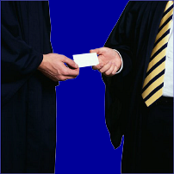
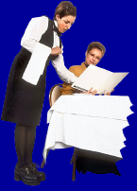
Section 3: Receiving clients
Business cards
It is quite common for people to exchange business cards, but there is no particular ritual attached to this. If your contact offers his card, then you can do likewise. Otherwise, this can be done at the end of the meeting.
Invitations to the restaurant
Invitations to the restaurant generally are generally restricted to lunchtimes, except if the meeting is to last several days. In this case, you may find yourself at the restaurant again in the evening!
The French don’t usually invite business contacts home for dinner. As a rule, they like keep professional life and private life separate.
(see also section 7: Entertaining)…
French Business Culture
AGERCEL

Slide 18
Section 4:
Business dress code
French Business Culture
AGERCEL

Slide 19
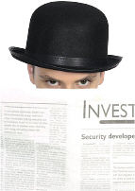
Section 4: Business dress code
Code vestimentaire
As a general rule, it’s a good idea to stick to fairly traditional clothes (see next slide for details) , but you can easly add a touch of colour with a scarf, a tie, some jewellery. These should be in good taste however.
French Business Culture
AGERCEL

Slide 20

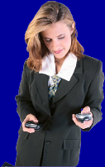
Section 4: Business dress code
Business dress code
Women
Choose a simple but elegant outfit. Accessories are a good idea, but should be chosen in good taste.
You can wear trousers, a skirt or a two-piece suit.
Skirts should of medium length. Long skirts and dresses are rarely worn at work.
In Summer, it is possible to do without stockings.
Men
Men often wear traditional clothes of very good quality.
A dark suit is perfect for winter, or a lighter one in Summer.
You can also wear a jacket and trousers, but make sure they are tastefully matched. A blazer and grey slacks is a popular combination
Men nearly always wear a tie, but choose discrete colours!
French Business Culture
AGERCEL

Slide 21
Section 5:
Addressing others
French Business Culture
AGERCEL

Slide 22
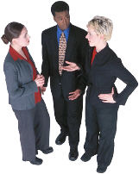
Section 5: Addressing others
Introduction
French people are usually quite formal in the way they speak to each other. This is especially true if they don’t know each other very well, or if there is a substantial age difference.
French Business Culture
AGERCEL

Slide 23
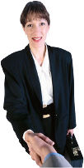
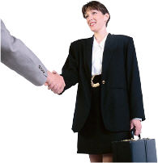
Section 4: Business dress code
Madame, Monsieur...
When you meet someone for the frst time, you should say,"Bonjour Madame, Bonjour Monsieur".
You do not have to say the person’s name, even if you know it.
You would only say "Bonjour, M. Lenoir« if you knew him quite well.
When speaking to a woman, use « Madame ».
It is increasingly rare to hear « Mademoiselle »
French Business Culture
AGERCEL

Slide 24
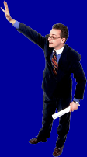
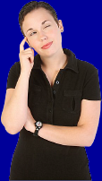
Section 4: Business dress code
TU or VOUS...?
You should stick to the « vous » form unless you are invited to use « tu ».
When speaking to a person much older than yourself, or someone who is hierarchically very important, you should always use the « vous » form.
In the same way, you should use first names only if your contact does so first, or if you are invited to do so.
Salut,
Gigi!
It can sometimes be hard to remember who you « tutoie » and who you say « vous » to !
French Business Culture
AGERCEL

Slide 25
Section 6:
Negotiating
French Business Culture
AGERCEL

Slide 26
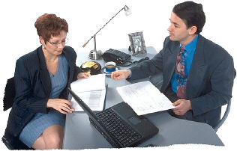
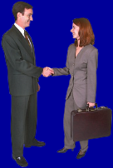
Introduction
A highly developped sense of logic, and a real taste for debate are two fundamental elements of French culture.
This means that the French are skilled negotiators who enjoy opposing different ideas and viewpoints.
As keen practitioners of the « win-win » philosophy, they consider negotiating to be not only a means of intellectual stimuation, but also a way of achieving satisfaction for all parties.
French Business Culture
AGERCEL

Slide 27
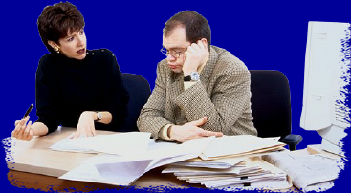
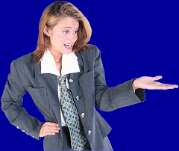

Section 6: Negotiating
If the debate becomes quite heated, don’t worry. It doesn’t necessarily mean that they are angry with you, or that the negotiations are going badly. French people like a lively discussion, and sometimes, the « latin » side of their temperament becomes apparent.
Don’t be afraid to defend your point of view, but be prepared to give some ground. The French don’t always appreciate intransigence. You should make allowances for this in the preparation stages.
You will be judged on your ability to defend your position eloquently, and to develop clear, substantial, well thought-out arguments.
The mood will generally be polite, civilised an earnest. Humour is not always welcome, and you should show a certain amount of restraint. Be careful of getting over-enthusiastic.
French Business Culture
AGERCEL

Slide 28
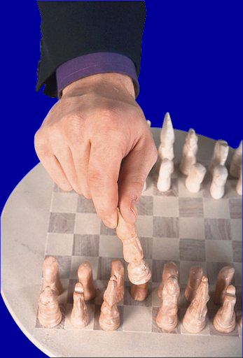
Section 6: Negotiating
As French companies are often organised according to a very hierarchical model, it’s a good idea to find out who’s who before the negotiations begin.
French Business Culture
AGERCEL

Slide 29
Section 7:
Entertaining
French Business Culture
AGERCEL

Slide 30
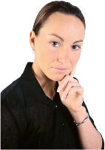
Section 7: Entertaining
Introduction
Relationships usually remain on a fairly formal basis, especially in the early stages. Things may warm up at a later stage in the proceedings, but this takes time. Do not think that this indicates unfriendliness. French people work on developing long-lasting relationships, with an emphasis on long-term objectives. Your patience will pay off in the end.
French Business Culture
AGERCEL

Slide 31
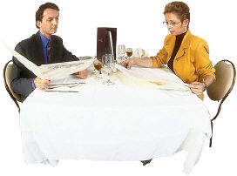
Section 7: Entertaining
At the restaurant
The business lunch is a key moment in professional life in France. But this does not necessarily mean that formal business dicussion is required.
It is considered an opportunity to get to know each other better, and to create a more relaxed working atmosphere. You can therefore avoid speaking about business altogether, unless your host brings up the subject first.
French Business Culture
AGERCEL

Slide 32
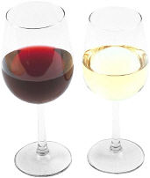
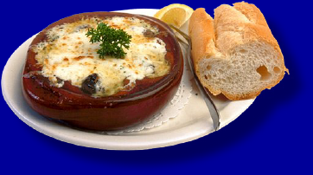
Section 7: Entertaining
At the restaurant
L'apéritif: You should avoid ordering spirits, but whisky would be an acceptable exception. Follow your host’s example, and don’t be afraid to ask for guidance!
Wine, or even several wines, will certainly be drunk with the meal.
Avoid ordering sweet fizzy drinks such as coke with the meal. If you don’t want to drink wine, you should order mineral water which will be either flat or sparkling.
The meal will consist of several dishes:
The starter, the main course, the cheese course (often local specialities), a dessert and a coffee. If you prefer, tea can be drunk instead of coffee, or you can order a « déca », a decaffeinated coffee.
French Business Culture
AGERCEL
BON APPETIT !

Slide 33
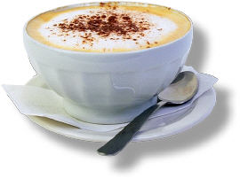
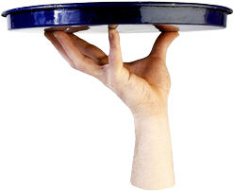
Section 7: Entertaining
Paying the bill
When the time comes to pay the bill, it’s usually up to the person who issued the invitation to pay for the meal. Generally speaking, it’s the supplier who invites the client. However, there may be exceptions to this rule, especially where people know each other well and eat together on a regular basis. In long-term business relationships, it is quite usual for people to take turns, but do not run the risk of offending your host by insisting too heavily.
If you are the one who issued the invitiation, take the initiative of asking the waiter or waitress for the bill.
To attract the waiter or waitresses attention, you should say « Monsieur / Madame, s'il vous plaît… »
Do not snap your fingers, as this considered very impolite!
The "digestif", (cognac, calvados or another liqueur) is sometimes offered after the coffee, but this is increasingly rare. French people consider it civilised to drink « with moderation », especially at lunchtime.
French Business Culture
AGERCEL

Slide 34
Section 8:
Public behaviour
French Business Culture
AGERCEL

Slide 35

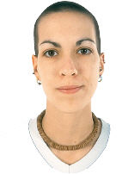
Section 8: Public behaviour
Smoking is forbidden in public places (public transport, cinemas etc.) and often in offices also. It is tolerated in restaurants, but in theory there are smoking and no-smoking areas.
Eating chewing-gum in public is considered very vulgar..
If you are seated when a person enters the room, you should rise before shaking their hand.
        French men treat women with great courtesy. Good old-fashioned etiquette is still very important.
French Business Culture
AGERCEL

Slide 36
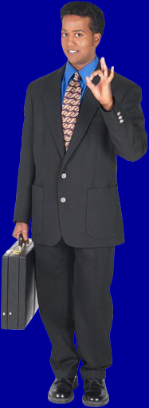
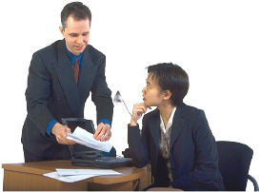
Section 8: Public behaviour
Be careful of using hand gestures. The same gesture can have a very different meaning !
Avoid making remarks,
even those which are intended
to be complimentary, about
people’s clothes.
This is likely to be
considered inappropriate.
If you don’t speak French, try to learn and use a few basic politeness expressions. Your efforts will be appreciated.
French Business Culture
AGERCEL

Slide 37
Section 9:
Regional differences
French Business Culture
AGERCEL

Slide 38
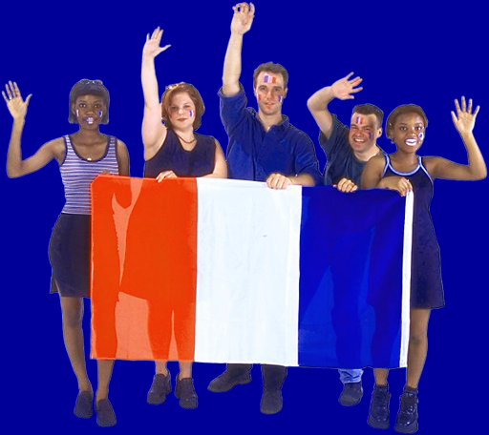
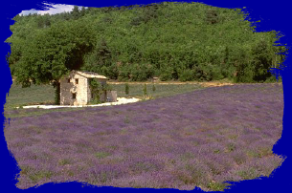
Section 9 : Regional differences
Most of the provincial regions of France have a very strong cultural identity, and their inhabitants will be delighted to explain them to you.
In certain regions, a local language is still spoken, such as Breton, Occitan, Corsican…
France has 22 distinct regions, 4 overseas « departments », the « DOM » as well as the other overseas territories (the « TOM »
Each region has several « départements », and has its traditional costumes and local gastronomic specialities.
French Business Culture
AGERCEL

Slide 39
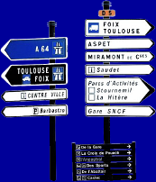
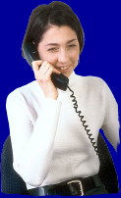
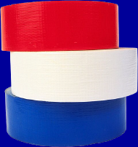
Section 9 : Regional differences
The climate in France varies greatly from North to South. As a result, you may find differences in working habits, especially in Summer. In the South, where temperatures can be very high, shops are often shut from noon till 3 pm. Offices are usually air-conditioned.
People in the North of France are proud of their reputation for being very industrious, but warm and friendly.
French Business Culture
AGERCEL

Slide 40
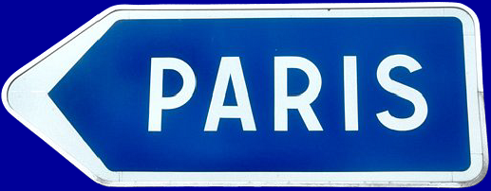
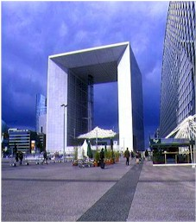
Section 9 : Regional differences
Paris is a very cosmopolitan city, open to the world around it.
The Parisian lifestyle, however, can be quite frenetic. Poeple working Paris often have to commute long distances, and spend a sizeable part of their day in public transport.
Many Parisians like to get out of the busy capital to spend a quiet weekend in the countryside or by the sea.
http://www.parisbreak.co.uk/images/s_grande_arche.jpg
More than 100 000 people work in the « La Défense » business complex.
If you have an internet connection, click here for more information about France and its culture:
www.francetourism.com
www.egide.asso.fr/fr/guide/connaitre/culture/
French Business Culture
AGERCEL

Slide 41
Section 10:
How to start a business in France
French Business Culture
AGERCEL

Slide 42
Section 10 : How to start a business in France
Official Organisations
Various bodies exist to formally register companies depending on their type. These oranisations have created a network of centralised registration centres called the "Centres de Formalités des Entreprises" (CFE).
(non-exhaustive list)
Type of company:
Organisation / CFE:
Commercial trading ou industrial firms
Limited Responsibility (SA, SARL)
Chambres de Commerce et d’Industrie
www.acfci.cci.fr
Sole traders, crafts, tradesmen
Chambre des métiers
www.apcm.com
Freelance, self-employed
URSSAF
www.urssaf.fr
French Business Culture
AGERCEL

Slide 43
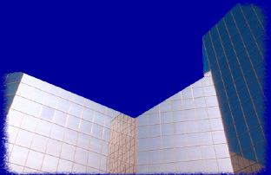
Section 10 : How to start a business in France
Help and incentives
At the end of 2003, a law came into existence (la loi pour l'initiative économique) with the aim of promoting the creation of companies in France
There are a number of schemes available. A complete list would be too long to provide here, but these are some of the main incentives:
Main incentives available:
tax allowances
temporary exemption from social security contributions
financial help with obtaining professional advice
enterprise zones
special conditions for job-seekers
The APCE website (l'Agence pour la Création d'Entreprise) is an excellent source of detailed information on this subject.
For more information:
www.apce.fr
www.pme.gouv.fr
www.portailpme.fr
French Business Culture
AGERCEL

Slide 44
Click here to do the
Final Test
French Business Culture
AGERCEL

Slide 45
More about...
Public holidays in France
All official organisations and most private firms close for these public holidays. Certain dates correspond to religious festivals, while others mark important dates in France’s history.
1st January : New Year’s Day
April: Easter Monday (date varies)
1st May: Labour Day
8th May: End of World War II
May (variable): Ascension Thursday
Mai (variable): Pentecost Monday
14th July: Fête nationale (Bastille day)
15th August: Feast of the Assumption
1st November: Toussaint (All Saints’)
11th November: Armistice 1918
25th December: Christmas Day
Back
French Business Culture
AGERCEL

